Slide 1


WELCOME

Slide 2
Note for the honourable teachers:
The subject teachers are requested to read the notes given below the slides.
Notes are given bellow the slide no. 8, 11, 12, 13 and 15.

Slide 3

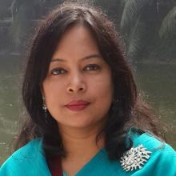
INTRODUCTION
ROUFUN NAHAR
Assistant Teacher( English)
Mizida Govt. High School, Tongi, Gazipur
SUBJECT: English 1st Paper
CLASS: Eight

Slide 4
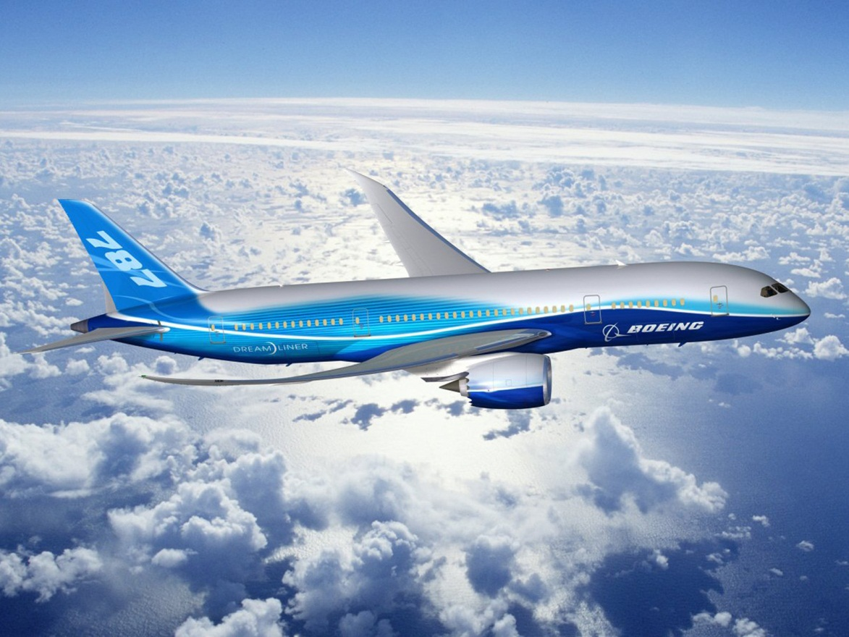
What can you see in the picture?

Slide 5
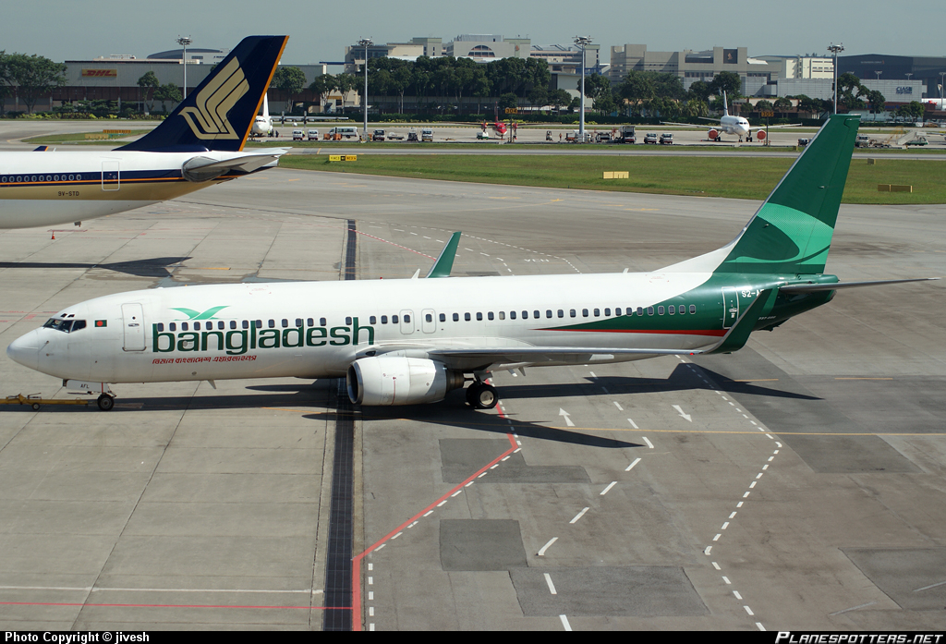
At the airport
Can you guess what is the place?

Slide 6
Topic’s name:
At the airport
Unit One
Lesson 1
Time: 50min.

Slide 7

OBJECTIVES OF THE LESSON
By the end of the lesson the students will be able to
ask and answer questions.
read and understand text.
write answers to questions.
write a short composition.
infer the meaning from the tex.

Slide 8
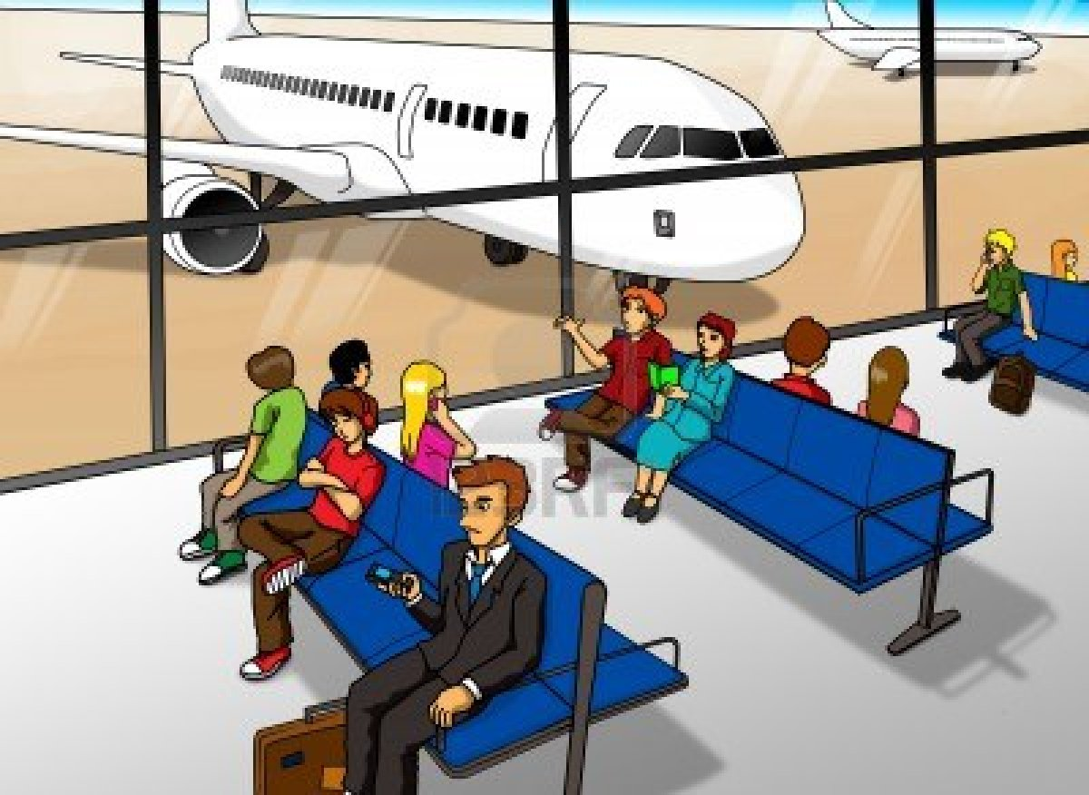
Lounge
Vocabulary
A room for waiting in at an airport
They are waiting in the lounge at the airport.
Notes:
First, the word will be shown. The SS will be asked to pronounce the word. If it is needed teacher can help. Then the picture and the sentence will be shown and asked to guess the meaning. After that the meaning will be shown. Then the teacher can ask the students to make a sentence of their own. In the same way, slide no. 8-12 can be conducted.

Slide 9
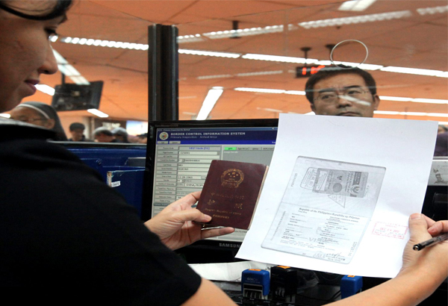
Immigration
An area at an airport, a sea port, etc. at which the
passports and other documents of people wanting
to come into a country are checked
The man is going through the immigration.

Slide 10

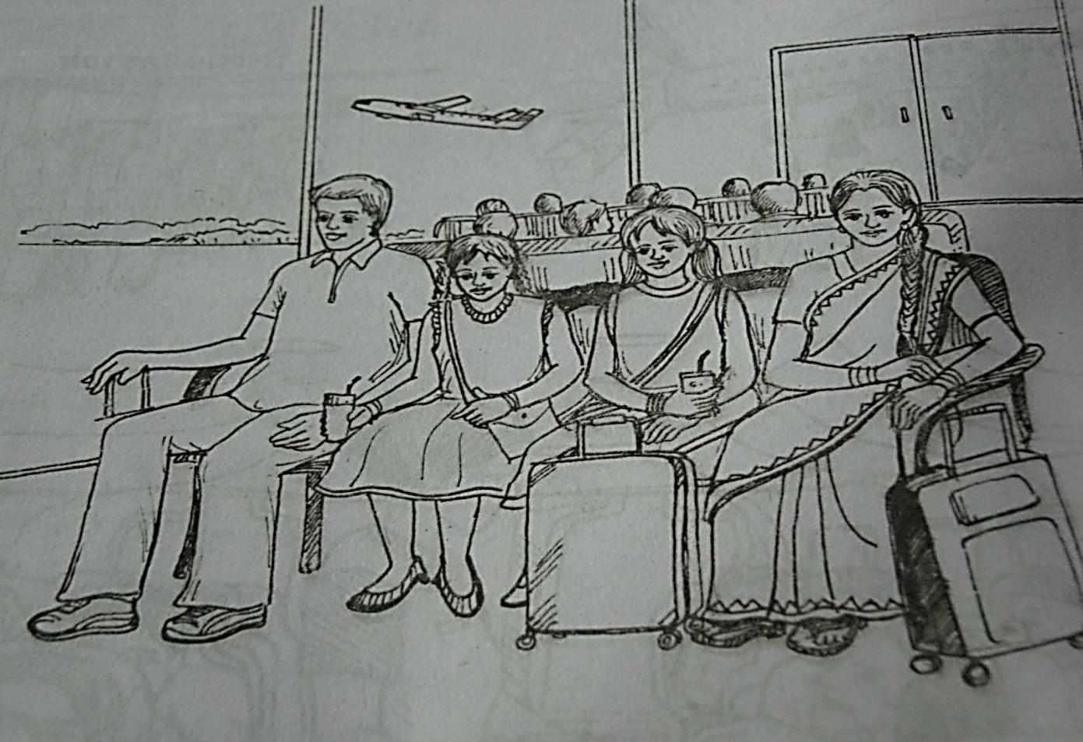


Talk about the picture with your partner
according to the following questions.(3min.)
1. What do you see?
2. Can you guess where it could be?
3. Who are the people in the picture?
4. What could be their relationship?

Slide 11

Read the text from the book and write answer of the following questions.
1. Why is Mita excited?
Ans: Mita is excited because this is her first time to board a plane.
2. Why aren’t Mita’s parents going with her?
Ans: Mita’s parents were too busy with their work.
3. What does an immigration officer do at the airport?
Ans: An immigration officer checks passport and stamps it.
Notes:
The teacher can ask SS to go to the textbook. After reading the passage student will find out the answer from the passage. 10 minutes can be given for the task. Then the teacher can elicit answer from 4/5 students. Then the teacher can show the answer.

Slide 12
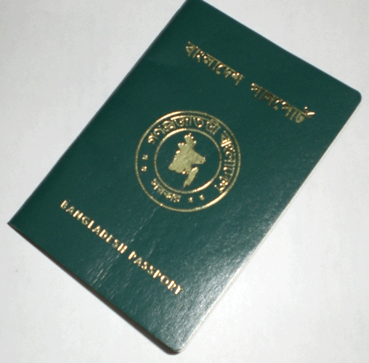
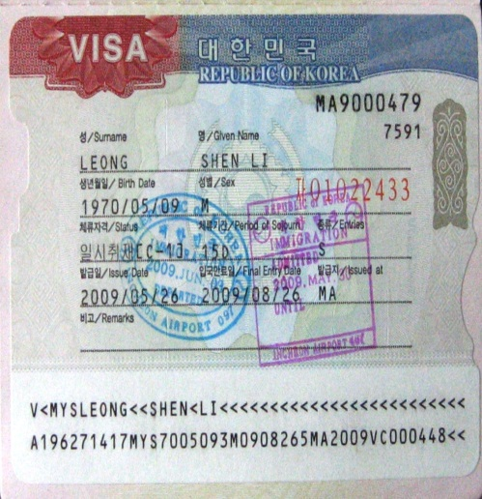
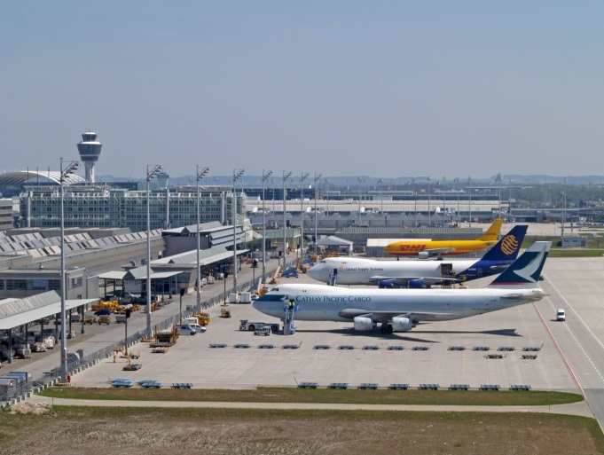
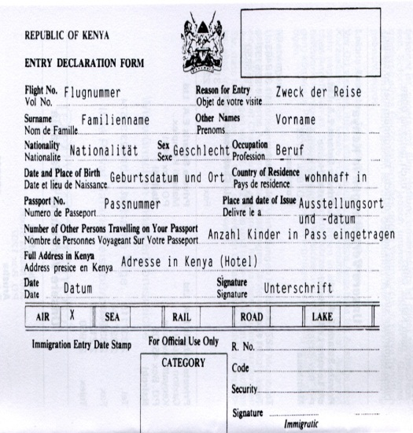
Preparation for going abroad
Notes:
The teacher can only show the slide or the question what they see in the picture as this slide is related to the slide no 14 where the students are asked to write a short composition about the preparation before travelling and the experience on the way.

Slide 13

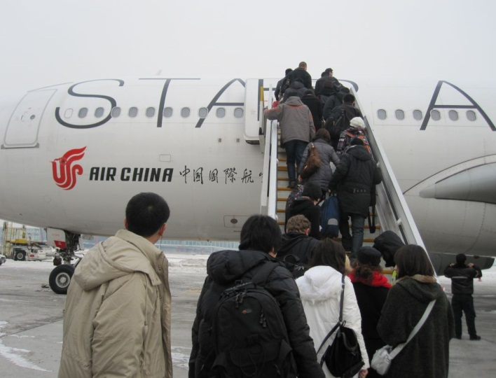
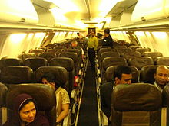
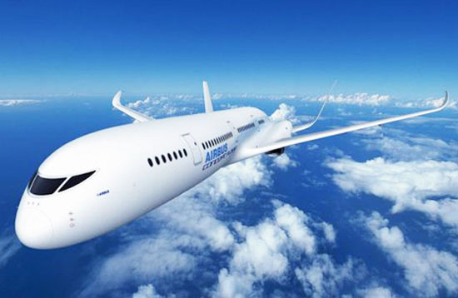
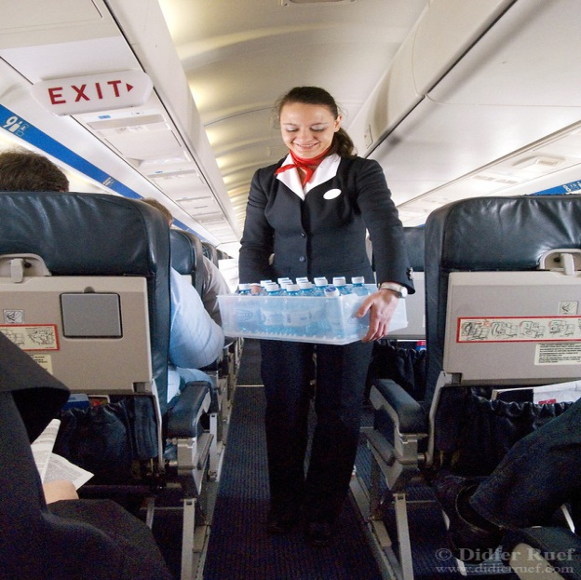
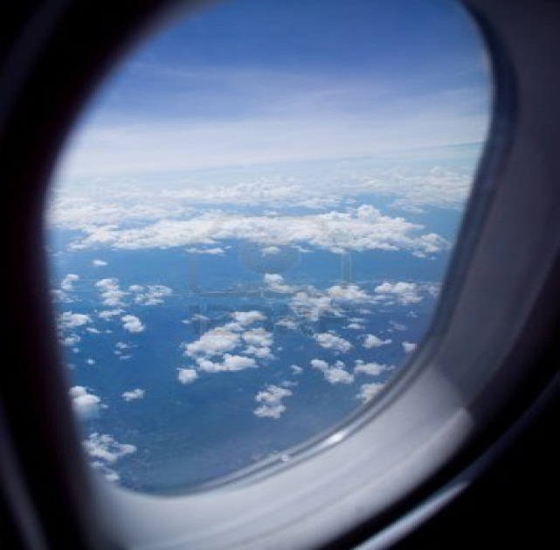
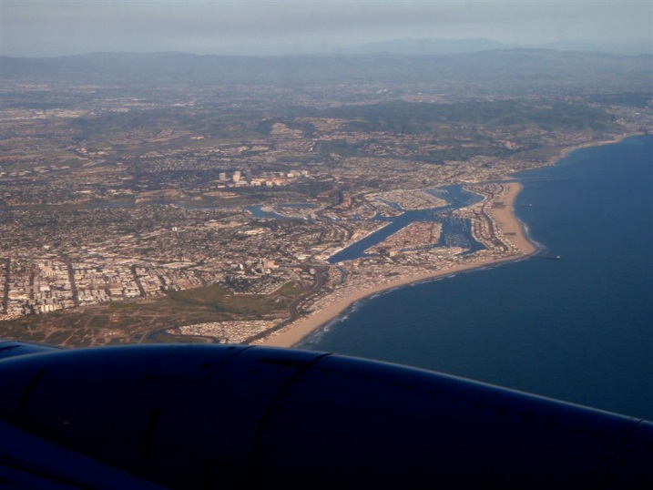
On the way while travelling
Boarding on the plane
Having seat
Plane flying
Air hostess’ service
Exciting view from the window
Notes:
The teacher can only show the slide or ask few questions as this slide is related to the slide no 14 where the students are asked to write a short composition about the preparation before travelling and the experience on the way.

Slide 14
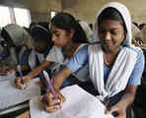
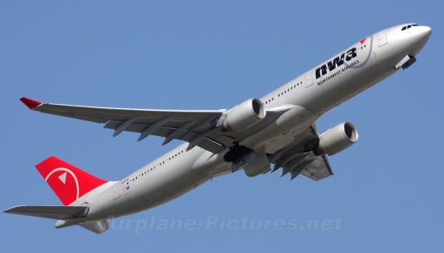
Individual Work
Think you are going to travel to Singapore by a plane.
Now write a short composition about your preparation before travelling and your experience on the way. (10 min.)

Slide 15
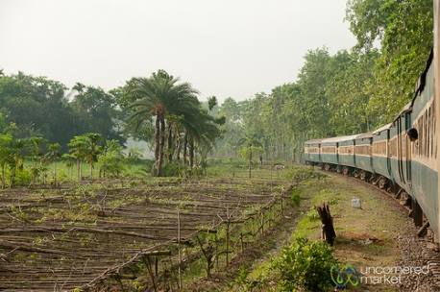
A trip to your grandparents’ house
Journey By A Train
Have A Look
Notes:
The slide no 15-18 is related to the home work.

Slide 16
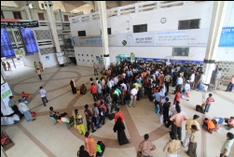
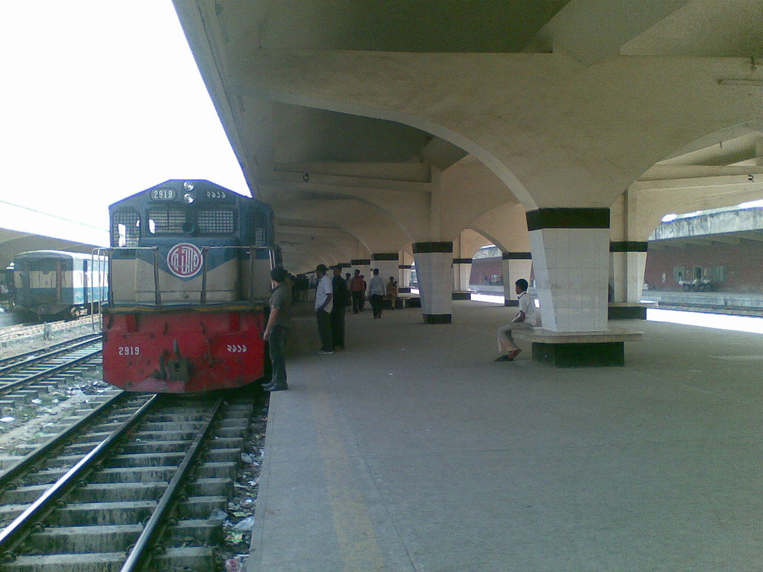

Slide 17
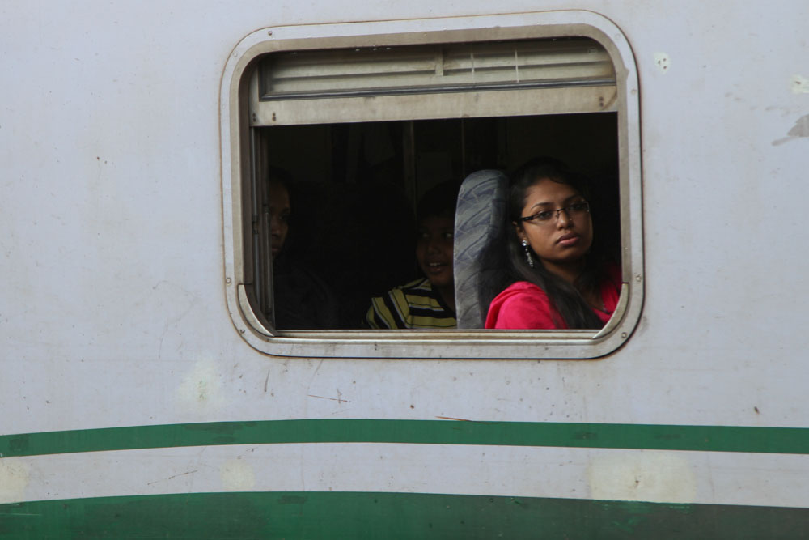
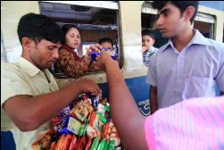
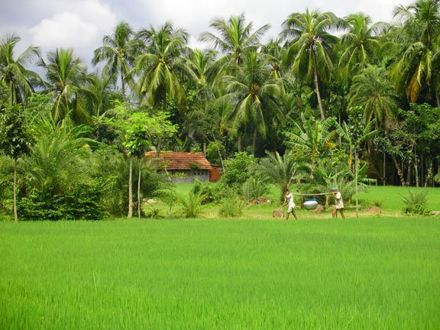
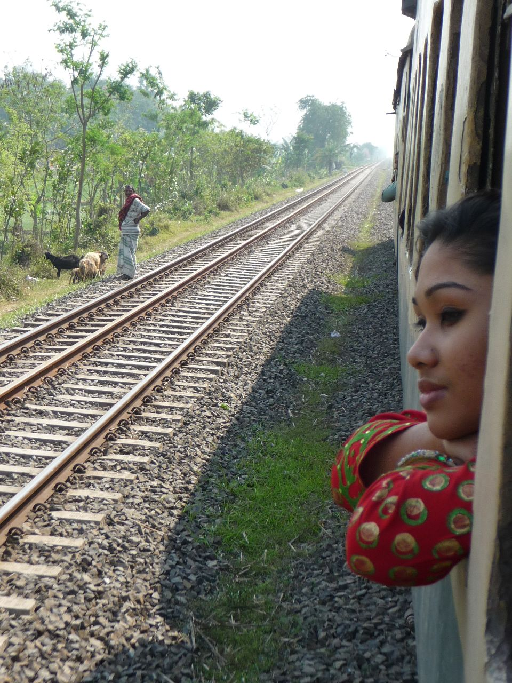

Slide 18
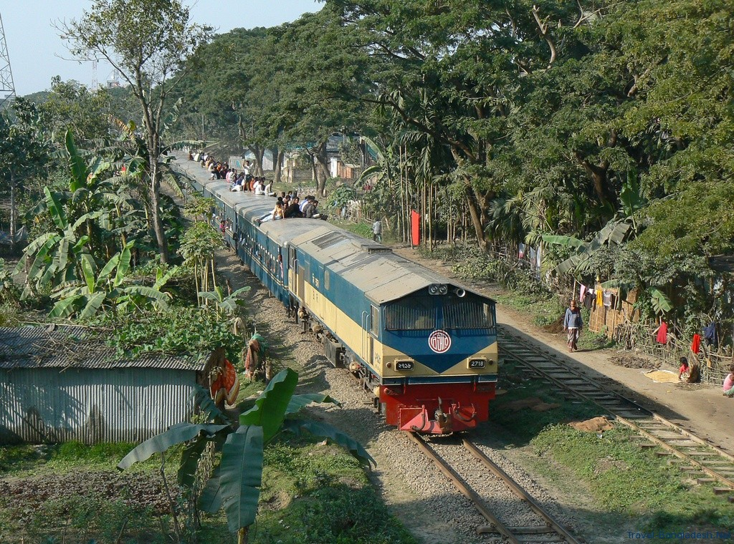

Slide 19

HOME WORK
Think you are going to travel to your grandparents’ house by a train. Now write a short composition about your preparation before travelling and your experience on the way. (Not more than 15 lines)

Slide 20
Acknowledgement
MoE, DSHE, NCTB & A2I respective of officials
And the editors panel: Ranjit Poddar, Associate Professor (English) TTC, Dhaka, Md. Jahangir Hasan (English), Assistant Professor TTC, Rangpur and Urmila Khaled Assistant Professor (English) TTC, Dhaka.
Their direction, valuable suggestions and intensive supervision have enriched the model contents.

Slide 21

THANK YOU ALL

